Slide 1
Basic Processing Unit
UNIT-5

Slide 2
Fundamental Concepts
Processor fetches one instruction at a time and perform the operation specified.
Instructions are fetched from successive memory locations until a branch or a jump instruction is encountered.
Processor keeps track of the address of the memory location containing the next instruction to be fetched using Program Counter (PC).
Instruction Register (IR)

Slide 3
Executing an Instruction
Fetch the contents of the memory location pointed to by the PC. The contents of this location are loaded into the IR (fetch phase).
IR ← [[PC]]
Assuming that the memory is byte addressable, increment the contents of the PC by 4 (fetch phase).
PC ← [PC] + 4
Carry out the actions specified by the instruction in the IR (execution phase).

Slide 4
Fetching an instruction and loading it into the IR is usually referred to as the instruction fetch phase.
Performing the operation specified in the instruction constitutes the instruction execution phase.
With few exceptions, the operation specified by an instruction can be carried out by performing one or more of the following actions:
• Read the contents of a given memory location and load them into a processor register.
• Read data from one or more processor registers.
• Perform an arithmetic or logic operation and place the result into a processor register.
• Store data from a processor register into a given memory location.

Slide 5
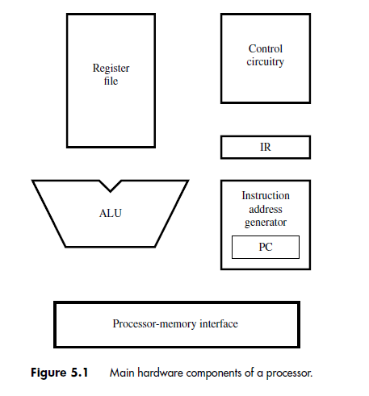

Slide 6
The hardware components needed to perform these actions are shown in Figure 5.1.
The processor communicates with the memory through the processor-memory interface, which transfers data from and to the memory during Read and Write operations.
The instruction address generator updates the contents of the PC after every instruction is fetched.
The register file is a memory unit whose storage locations are organized to form the processor’s general-purpose registers.
During execution, the contents of the registers named in an instruction that performs an arithmetic or logic operation are sent to the arithmetic and logic unit (ALU), which performs the required computation.
The results of the computation are stored in a register in the register file.

Slide 7
Instruction Execution
Load Instructions
Consider the instruction Load R5, X(R7) which uses the Index addressing mode to load a word of data from memory location X + [R7] into register R5. Execution of this instruction involves the following actions:
• Fetch the instruction from the memory.
• Increment the program counter.
• Decode the instruction to determine the operation to be performed.
• Read register R7.
• Add the immediate value X to the contents of R7.
• Use the sum X + [R7] as the effective address of the source operand, and read the contents of that location in the memory.
• Load the data received from the memory into the destination register, R5.

Slide 8
Arithmetic and Logic Instructions
They differ from the Load instruction in two ways:
• There are either two source registers, or a source register and an immediate source operand.
• No access to memory operands is required.
A typical instruction of this type is Add R3, R4, R5 It requires the following steps:
1. Fetch the instruction and increment the program counter.
2. Decode the instruction and read the contents of source registers R4 and R5.
3. Compute the sum [R4] + [R5].
4. Load the result into the destination register, R3.

Slide 9
Store Instructions
The five-step sequence used for the Load and Add instructions is also suitable for Store instructions, except that the final step of loading the result into a destination register is not required.
The hardware stage responsible for this step takes no action. For example, the instruction Store R6, X(R8) stores the contents of register R6 into memory location X + [R8]. It can be implemented as follows:

Slide 10
Fetch the instruction and increment the program counter.
Decode the instruction and read registers R6 and R8.
Compute the effective address X + [R8].
Store the contents of register R6 into memory location X + [R8].
No action.

Slide 11
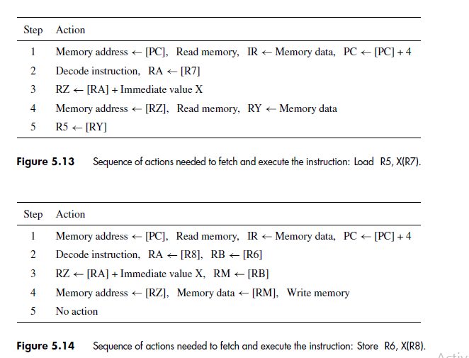

Slide 12
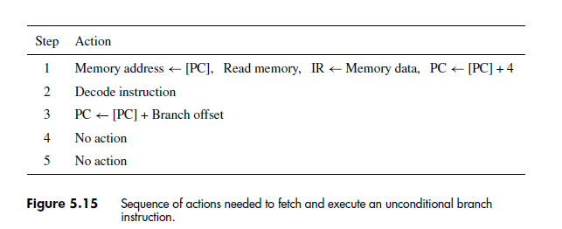

Slide 13
A five-step sequence of actions to fetch and execute an instruction
Step Action
Fetch an instruction and increment the program counter.
Decode the instruction and read registers from the register file.
Perform an ALU operation.
Read or write memory data if the instruction involves a memory operand.
Write the result into the destination register, if needed.

Slide 14
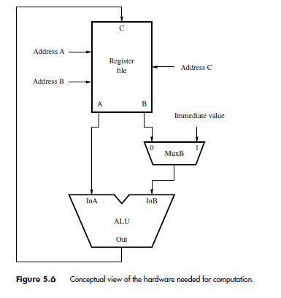
ALU

Slide 15
The arithmetic and logic unit is used to manipulate data. It performs arithmetic operations such as addition and subtraction, and logic operations such as AND, OR, and XOR.
Conceptually, the register file and the ALU may be connected as shown in Figure 5.6. When an instruction that performs an arithmetic or logic operation is being executed, the contents of the two registers specified in the instruction are read from the register file and become available at outputs A and B.
Output A is connected directly to the first input of the ALU,
InA, and output B is connected to a multiplexer, MuxB. The multiplexer selects either output B of the register file or the immediate value in the IR to be connected to the second
ALU input, InB. The output of the ALU is connected to the data input, C, of the register file so that the results of a computation can be loaded into the destination register.

Slide 16
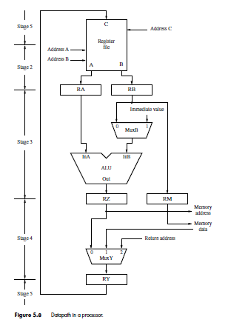

Slide 17
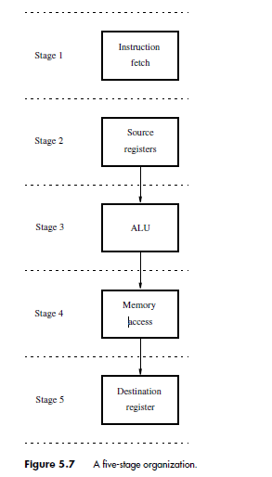

Slide 18
We now need to organize the hardware into a multi-stage structure similar to that in
A possible structure is shown in Figure 5.7. The actions taken in each of the five stages are completed in one clock cycle.
An instruction is fetched in step 1 by hardware stage 1 and placed into the IR.
It is decoded, and its source registers are read in step 2.
The information in the IR is used to generate the control signals for all subsequent steps. Therefore, the IR must continue to hold the instruction until its execution is completed.

Slide 19
It is necessary to insert registers between stages. Inter-stage registers hold the results produced in one stage so that they can be used as inputs to the next stage during the next clock cycle.
This leads to the organization in Figure 5.8. The hardware in the figure is often referred to as the datapath. It corresponds to stages 2 to 5 in Figure 5.7. Data read from the register file are placed in registers RA and RB.
Register RA provides the data to input InA of the ALU. Multiplexer MuxB forwards either the contents of RB or the immediate value in the IR to the ALU’s second input, InB.
TheALU constitutes stage 3, and the result of the computation it performs is placed in register RZ

Slide 20
Recall that for computational instructions, such as an Add instruction, no processing actions take place in step 4.
During that step, multiplexerMuxYin Figure 5.8 selects register RZ to transfer the result of the computation to RY.
The contents of RYare transferred to the register file in step 5 and loaded into the destination register. For this reason, the register file is in both stages 2 and 5. It is a part of stage 2 because it contains the source register and a part of stage 5 because it contains the destination register.

Slide 21
For Load and Store instructions, the effective address of the memory operand is computed by theALU in step 3 and loaded into register RZ. From there, it is sent to the memory, which is stage 4.
In the case of a Load instruction, the data read from the memory are selected by multiplexer MuxY and placed in register RY, to be transferred to the register file in the next clock cycle.
For a Store instruction, data are read from the register file, which is part of stage 2, and placed in register RB. Since memory access is done in stage 4, another inter-stage register is needed to maintain correct data flow in the multi-stage structure.
Register RM is introduced for this purpose. The data to be stored are moved from RB to RM in step 3, and from there to the memory in step 4. No action is taken in step 5 in this case

Slide 22
Hardwired Control
We now examine how the processor generates the control signals that cause these actions to take place in the correct sequence and at the right time.
There are two basic approaches: hardwired control and microprogrammed control.
Hardwired control is discussed in this section.
An instruction is executed in a sequence of steps, where each step requires one clock cycle. Hence, a step counter may be used to keep track of the progress of execution.
Several actions are performed in each step, depending on the instruction being executed. In some cases, such as for branch instructions, the actions taken depend on tests applied to the result of a computation or a comparison operation.

Slide 23
External signals, such as interrupt requests, may also influence the actions to b performed. Thus, the setting of the control signals depends on:
Contents of the step counter
• Contents of the instruction register
• The result of a computation or a comparison operation
• External input signals, such as interrupt requests
The circuitry that generates the control signals may be organized as shown in Figure 5.21.
The instruction decoder interprets the OP-code and addressing mode informationin the IR and sets to 1 the corresponding INSi output.
During each clock cycle, one of the outputs T1 to T5 of the step counter is set to 1 to indicate which of the five steps involved in fetching and executing instructions is being carried out.

Slide 24
Since all instructions are completed in five steps, a modulo-5 counter may be used. The control signal generator is a combinational circuit that produces the necessary control signals based on all its inputs.
The required settings of the control signals can be determined from the action sequences that implement each of the instruction represented by the signals INS1 to INSm.

Slide 25
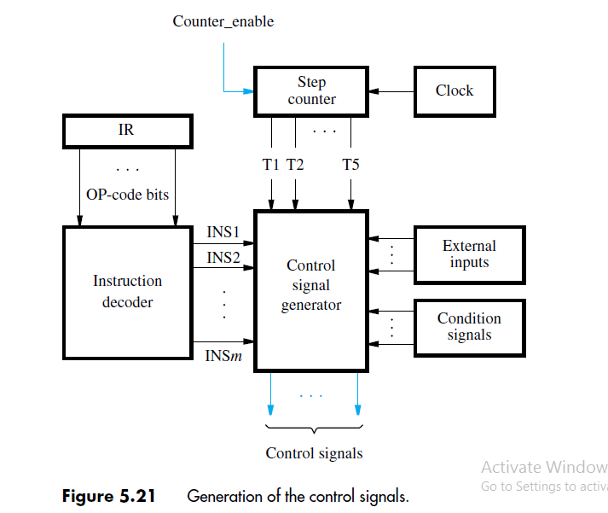

Slide 26
As an example, consider step 1 in the instruction execution process. This is the step in which a new instruction is fetched from the memory. It is identified by signal T1 being asserted.
During that clock period, the MA_select signal in Figure 5.19 is set to 1 to select the PC as the source of the memory address, and MEM_read is activated to initiate a memory Read operation.
The data received from the memory are loaded into the IR by activating IR_enable when the memory’s response signal, MFC, is asserted. At the same time, the PC is incremented by 4, by setting the INC_select signal in Figure 5.20 to 0 and PC_select to 1.
The PC_enable signal is activated to cause the new value to be loaded into the PC at the positive edge of the clock marking the end of step T1.

